Slide 1
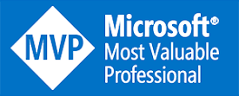
Analytics Foundation with Fabric Warehouse
John Miner Data Architect
john.miner@insight.com

Slide 2
Purpose
Microsoft Fabric went to General Availability in November of 2023. How can we leverage this new service to solve out business problems?
Right now, there are four types of problems that can be solved with Fabric: lake house, data warehouse, data science and real time analytics.
Today, we are going to explore how you can use fabric warehouse for analytics.

Slide 3
Topics of Discussion
Architecture Diagrams
Data ingestion
Metadata Driven Design
Full Load vs Incremental Loads
Hybrid configuration

Slide 4
Common analytics scenarios
Lakehouse
Data Warehouse
Data Science
Real Time Analytics
Notes:
Microsoft Fabric supports four common end-to-end analytics scenarios:
Lakehouse
Data Warehouse
Data Science
Real Time Analytics
Keep in mind that while these are the most common scenarios supported by Microsoft Fabric, there are many others that technical and business end-users can navigate through.

Slide 5

Data warehouse
Data Source
Ingestion
Store
Expose
Shortcut Enabled
Mounts
Data Warehouse
PBI
Structured / Unstructured
Pipelines & Dataflows
Warehouse
Transform
Procedures
Notes:
The Data Warehouse analytics scenario takes existing sources that are mounted, while pipelines and dataflows can bring in all other data that is needed.
IT teams can then define and store procedures to transform the data, which is stored as Parquet/Delta Lake files in OneLake.
From there, business users can analyze and visualize data with Power BI, again using the see-through mode or SQL endpoints.

Slide 6
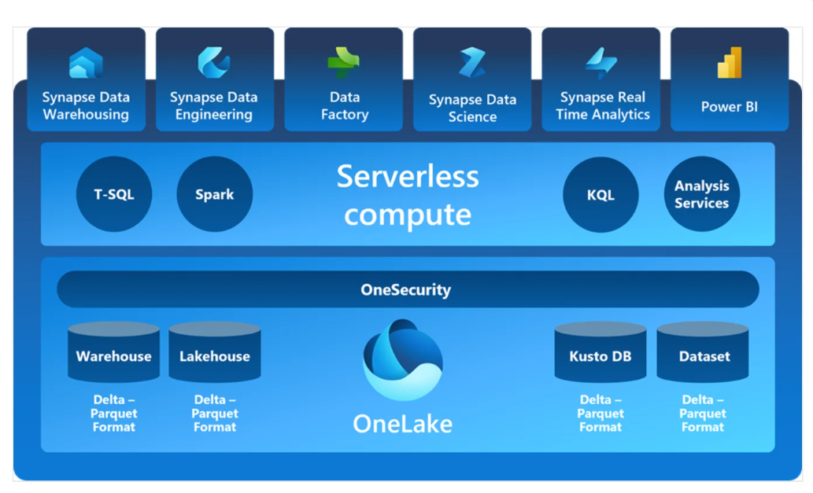
Delta Format @ Heart of One Lake

Slide 7
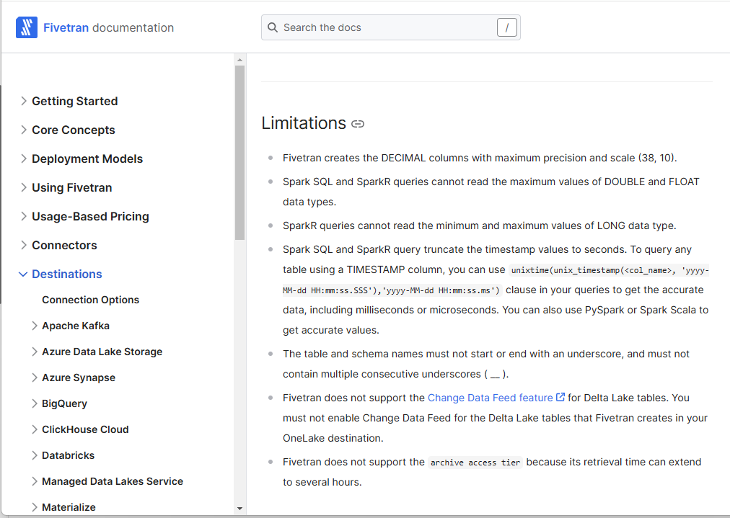
Data Ingestion – Third Party Tools
Fivetran
Let someone else worry about the EL into one lake.
Supports type 1 slowly changing dimensions.
Can surface data into warehouse using SQL analytics endpoint.

Slide 8
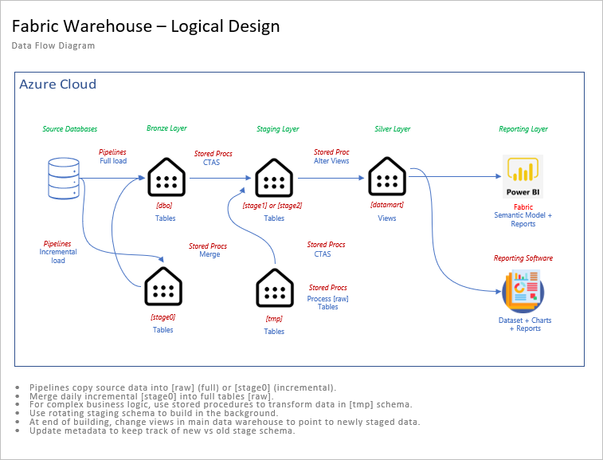
Metadata driven design
Fabric
Copy activity is the main action to ingest data.
Use schemas for data quality.
Use schemas for point in time builds.
Alter views to review newly ingested or calculated data.

Slide 9
Various Schemas
Schemas
Quality – raw (bronze) and refined (silver/gold).
Meta – controls data pipelines, staging and logging.
Stages – used for incremental loads and rebuilds.
Tmp – used to create those gold tables.
Schema Name | Description
meta | The metadata tables are used to control the data pipelines.
raw | A complete copy of the data.
stage0 | Contains the most recent incremental data.
stage1 | Copy of raw table at point in time x.
stage2 | Copy of raw table at point in time y.
refined | Views that point to a given stage.
tmp | Business logic and data aggregation.

Slide 10
Data Pipelines
Object Name | Type | Description
dw_advwrks_analytics | Fabric Warehouse | Target system.
nb-advwrks-2012-lt | T-SQL Notebook | Notebook created by Generative AI script.
nb-make-meta-data | T-SQL Notebook | The metadata tables are used as program inputs.
nb-make-refined-layer | T-SQL Notebook | Contains stored procedures to refresh staging and refined schemas.
pl_data_load_step | Data Pipeline | Full or incremental table copy from source to destination.
pl_exec_job_steps | Data Pipeline | For given job, start and stop steps, execute the full load data pipeline.
pl_sched_daily_load | Data Pipeline | Call to execute job steps by job id.

Slide 11
Generative AI
Problem:
We want to get the Sales LT data from SQL Server on-premises to Microsoft Fabric Warehouse.
Tasks:
We need to define the tables in the Fabric Warehouse.
We need to create metadata for data ingestion.
Solution:
We can use GitHub copilot to write T-SQL notebooks.

Slide 12
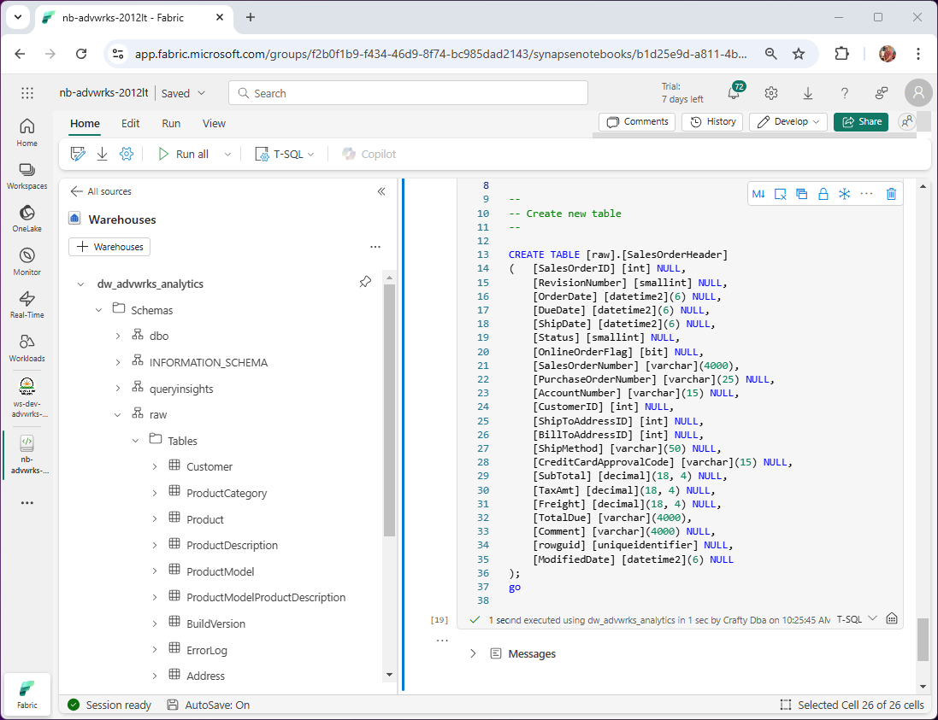
Objects in Warehouse
Objects
Raw – based tables on source system with changes for Warehouse T-SQL.
Stage [1|2] – tables are created using CTAS with raw as the source.
Stage [0] – used for incremental table loads. Use change tracking on source tables and custom merge stored proc to destination.
Refined – refresh views to point to correct stage.

Slide 13
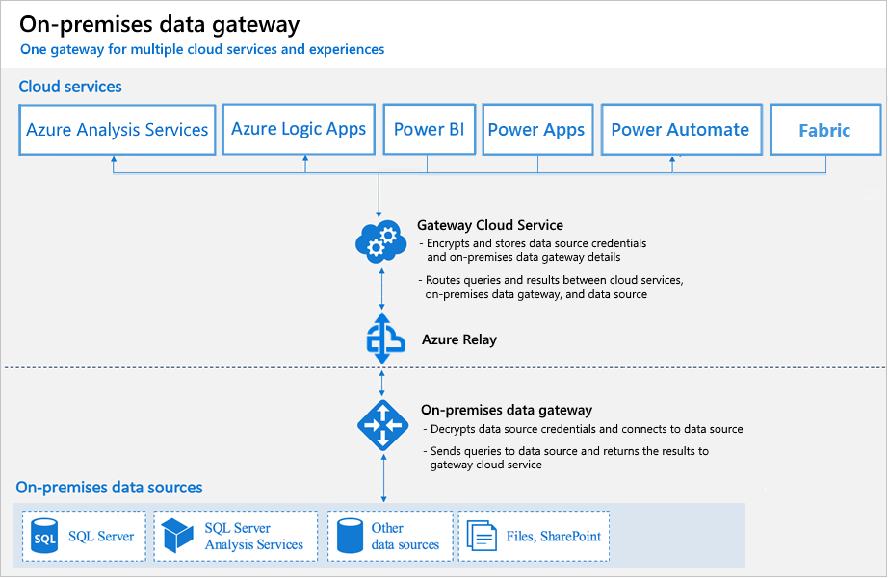
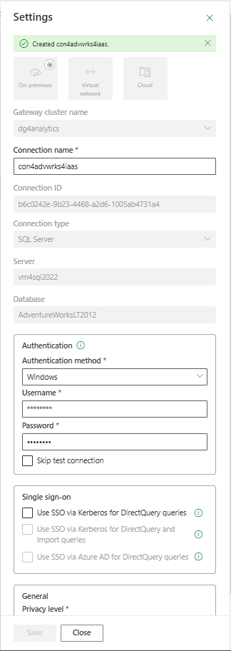
Data Gateway Configuration
Setup
Don’t forget about OS and Cloud firewall rules.
Trust certificate setting is now a config file entry.
Staging for copy activity must use external storage.
Must mark connection for use with data gateway.

Slide 14
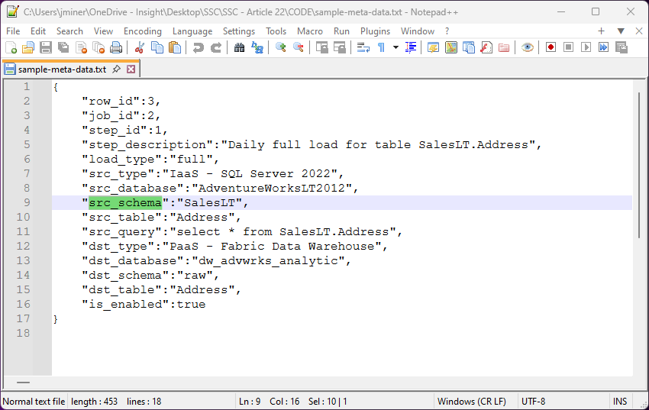
Sample Job Data
Data elements
Describe both source and destination data sets.
Setup row id, job id and step id.
Allow for optional disabling of a job.

Slide 15
Metadata Objects
Table + Views
The job and log tables are key to the data pipelines.
The control and datasets which tables are staged.
The code for staging view provides dynamic T-SQL for build and releasing new data.
Object Name | Type | Description
Controls | Table | Key value pairs such as the current staging schema.
DataSets | Table | List of tables to CTAS to a given stage.
Jobs | Table | The extract and load metadata.
Logs | Table | Logging of all actions and results.
uvwCode4Staging | View | Drop stage table, CTAS stage table, and alter view dynamic code.
uvwControlTable | View | Inserts prevent blocking. View uses row number and date to retrieve most recent record.
uvwUserTableInfo | View | Describe

Slide 16
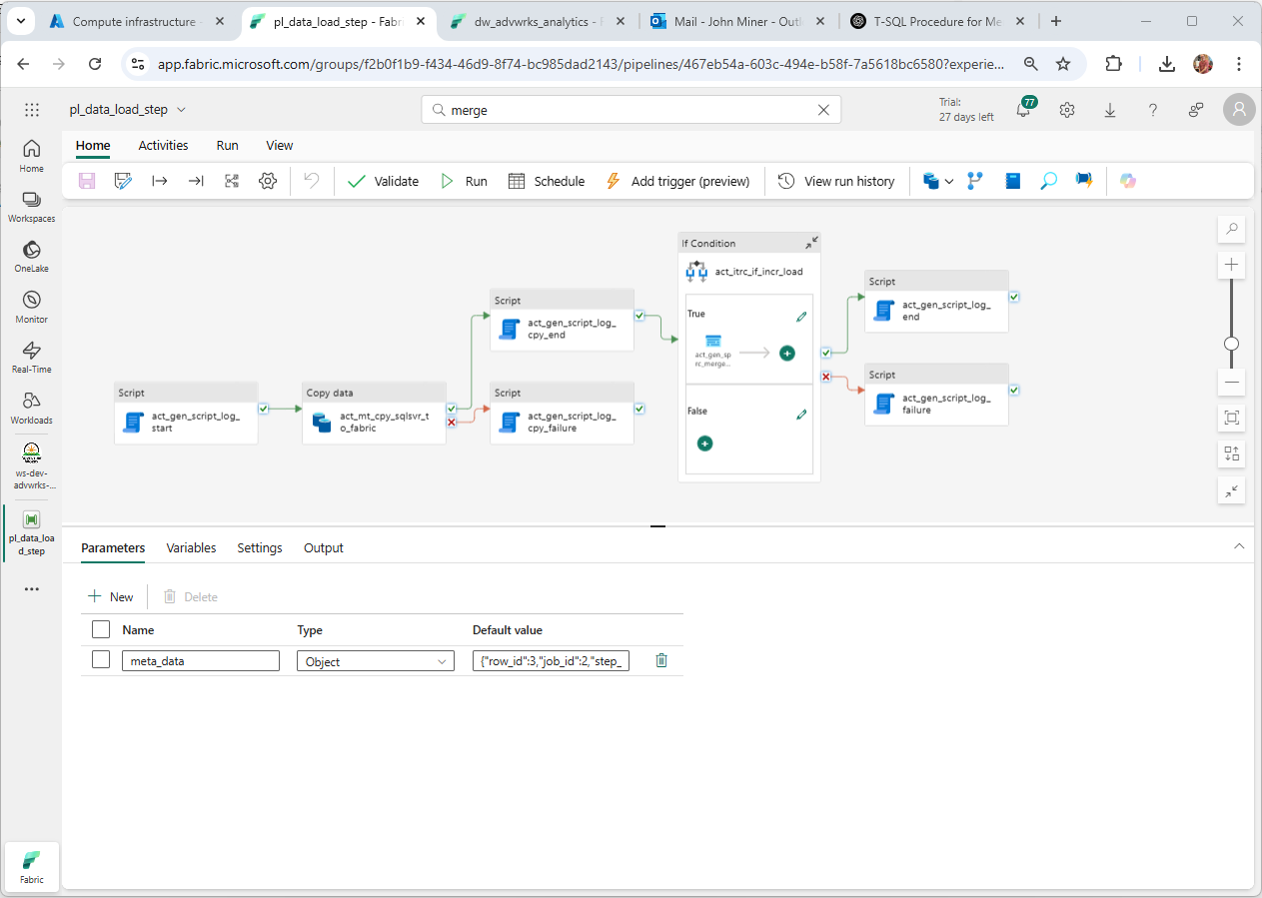
Data Load Pipeline
Pipeline Components
Input parameter.
Copy activity.
Script activity.
Log 3 success points.
Log 2 failure points.

Slide 17
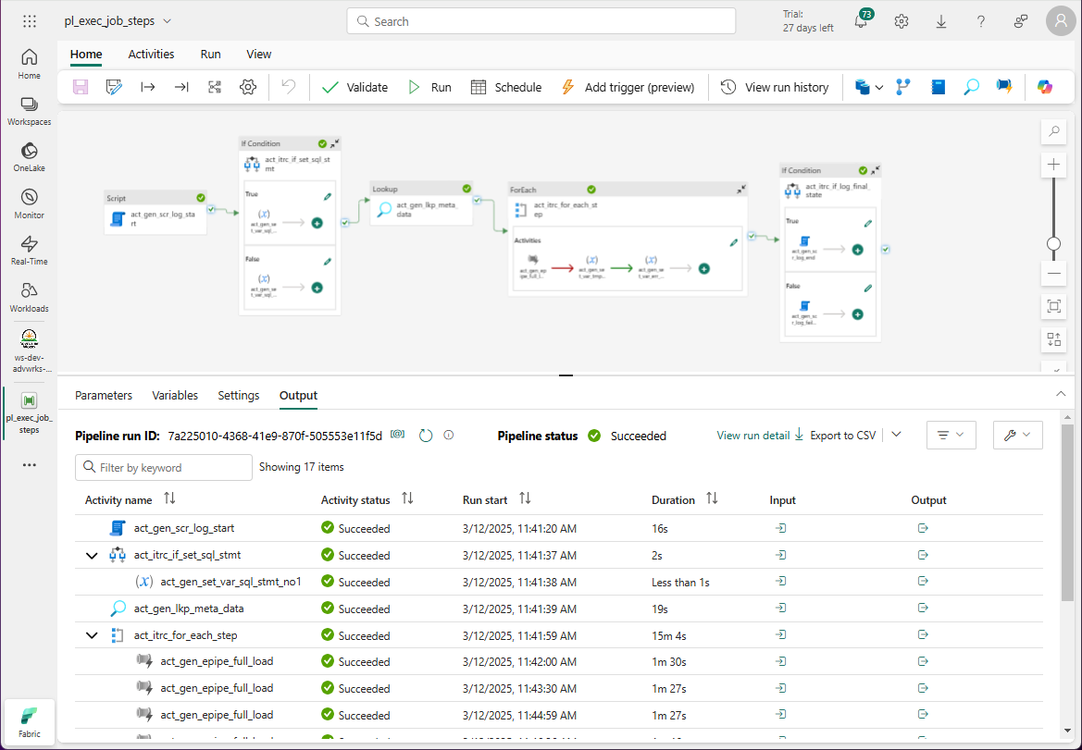
Job Execution Pipeline
Pipeline Components
3 input parameters
Set T-SQL variable to retrieve metadata.
Lookup matching job/steps in metadata.
For each step, call data load pipeline.
Count errors.
Log success if error count is zero.

Slide 18
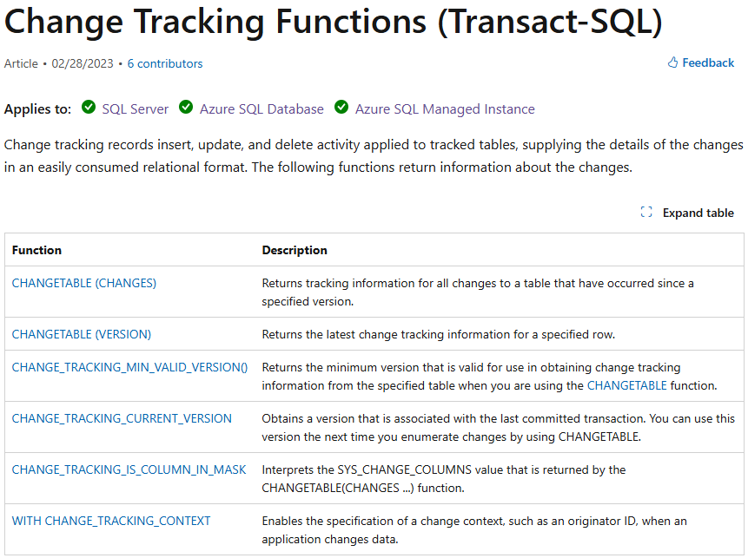
Change Table Tracking
Source System (SCD-1)
Enable CT on database and tables.
Create custom table to save last version per table.
Use complex query to retrieve data into [stage0] table.
Merge [stage0] table into [raw] table.

Slide 19
Summary
Microsoft Fabric is the one stop shop for all your data and analytical needs. Today, we focused on how to ingest data into a Fabric Warehouse. There are several source systems that can be mirrored into Fabric currently. However, not all relational database management systems will have enough market share to warrant Microsoft to write an interface.
Metadata driven pipelines are a real option for those systems that do not have mirroring. For cloud born databases, the drivers are already available in Fabric for a connection. On premises databases will need a data gateway. The hardest part of the process is configuring both the virtual machine and the Fabric connection. In short, the metadata driven design reduces the total amount of code to maintain.
Generative AI can be used to transform source tables in target tables and metadata entries. This reduces the amount of typing. While this technology is in its infancy, I expect our use of LLMs to be common day practice in the future.
If you have your skill set includes SQL and Python, you should be right at home with the new product offerings. The future is bright for those who can adapt to the Fabric ecosystem.

Slide 20
References
Fabric - Data Factory
https://tinyurl.com/y9r4ee7p
Fabric – Lake House
https://tinyurl.com/4fdk4bux
Fabric - Notebooks
https://tinyurl.com/5bydabub
Fabric – Data Warehouse
https://tinyurl.com/bdedrec4
Fabric – Deployment pipelines
https://tinyurl.com/msyt28nb
Fabric - Mirroring
https://tinyurl.com/84z45n8y
Fabric – Data Gateway
https://tinyurl.com/3svxpbvd
Git Hub Co-Pilot
https://tinyurl.com/29kdpwdn
Change Tracking
https://tinyurl.com/37h8yam3
Expression Language
https://tinyurl.com/mr44vpfz

Slide 21
Questions / Thank You

